Slide 1
Big Data - Hadoop
Prepared by Chala Urgessa

Slide 2
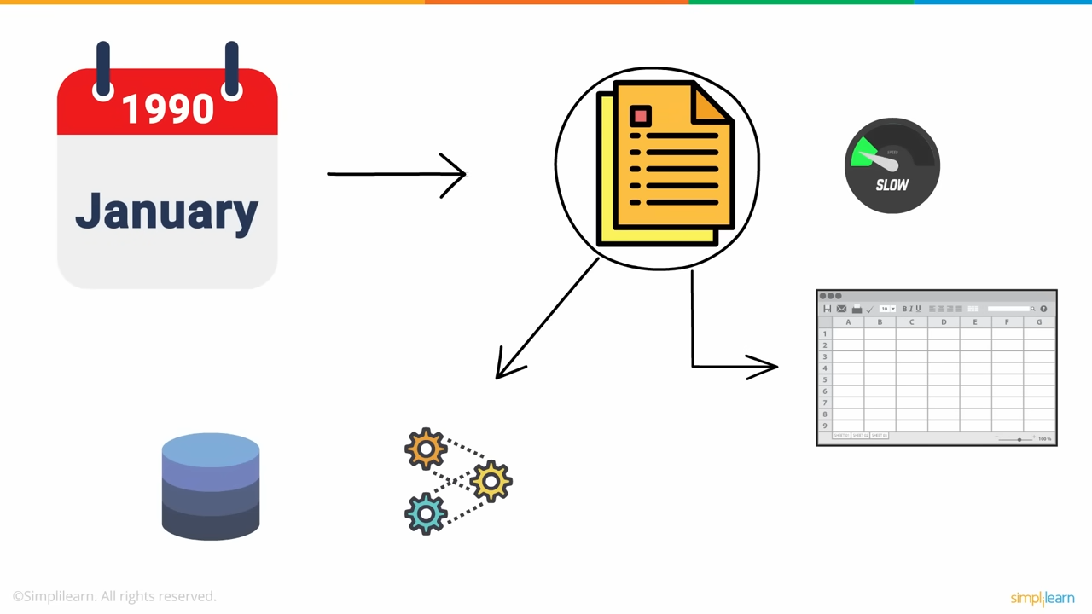

Slide 3
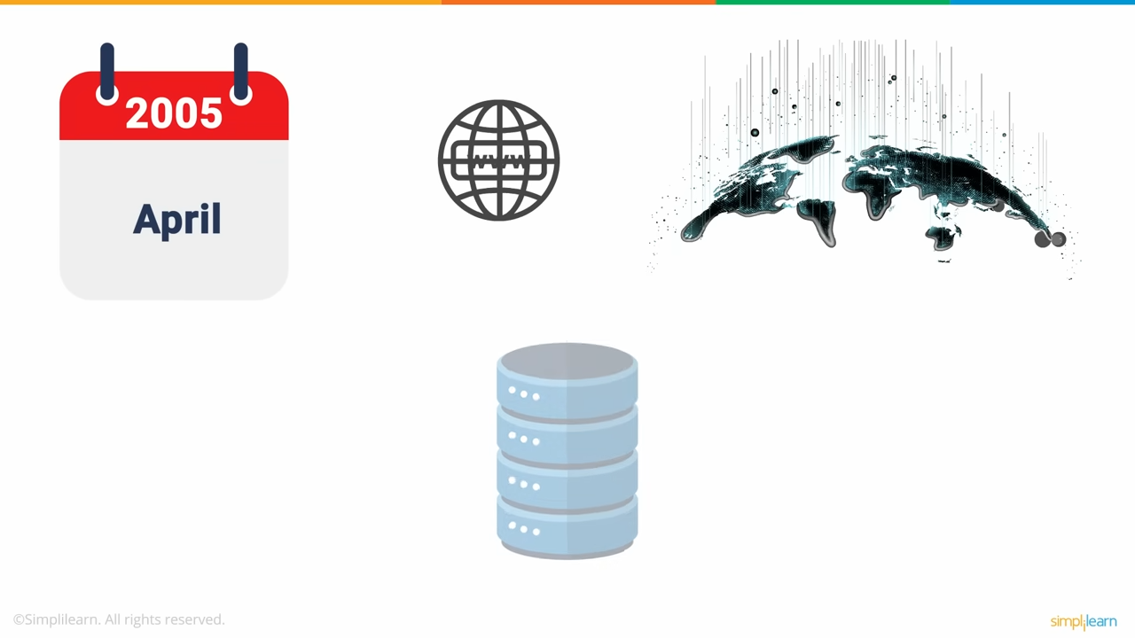

Slide 4
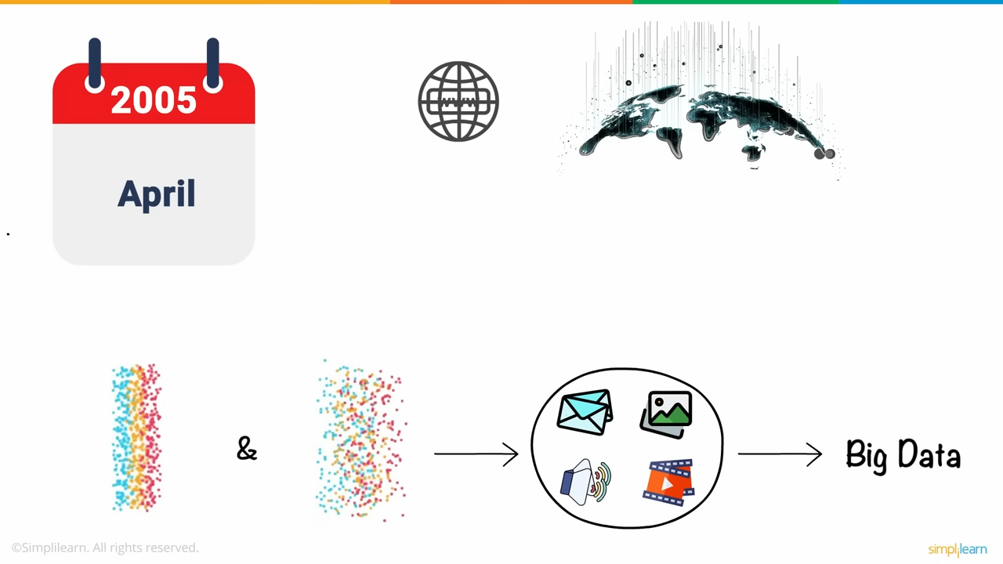
Notes:
Semi structured and unstructured

Slide 5
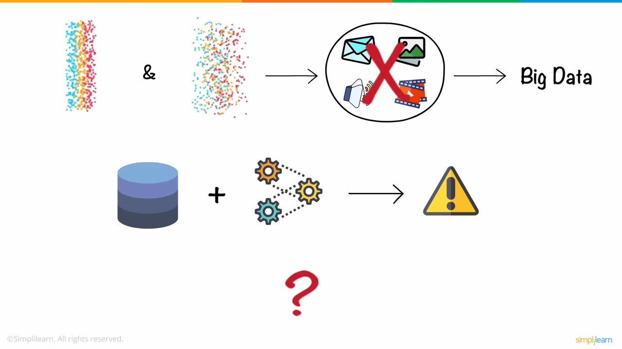
Storage unit processor combination was obviously not enough

Slide 6
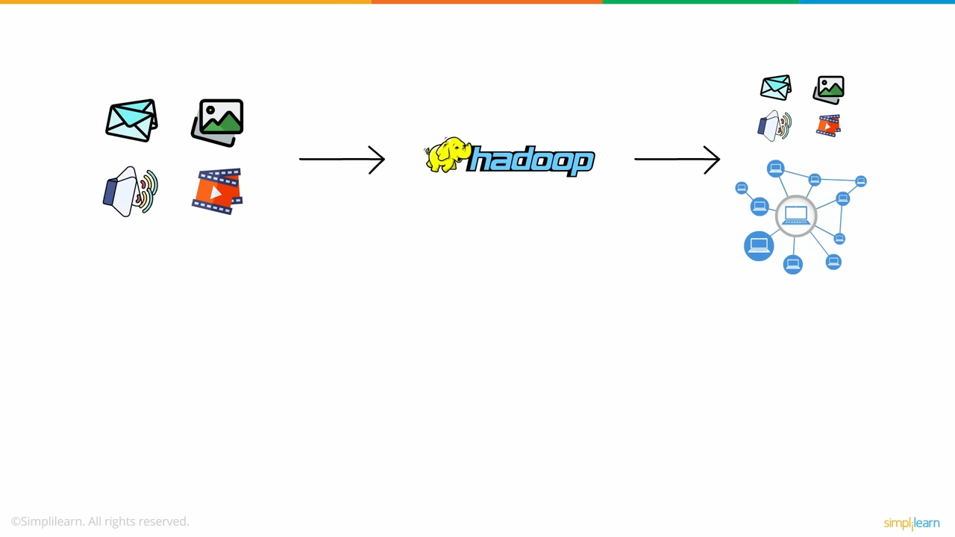

Slide 7
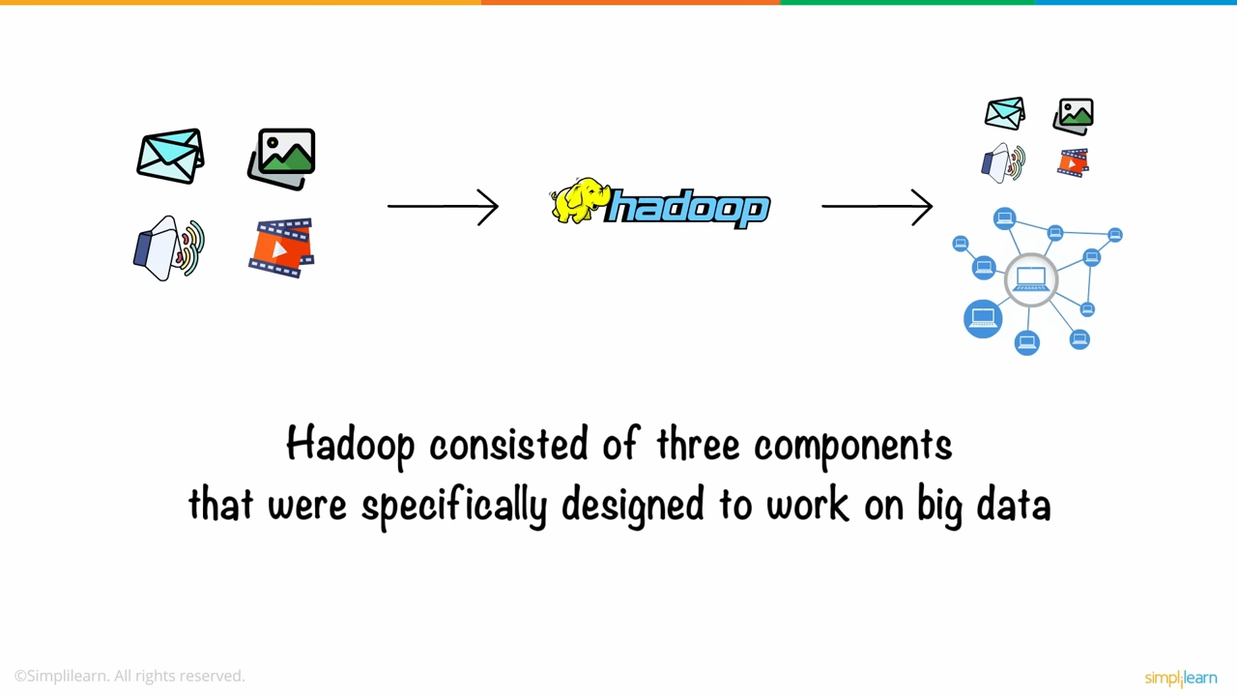

Slide 8
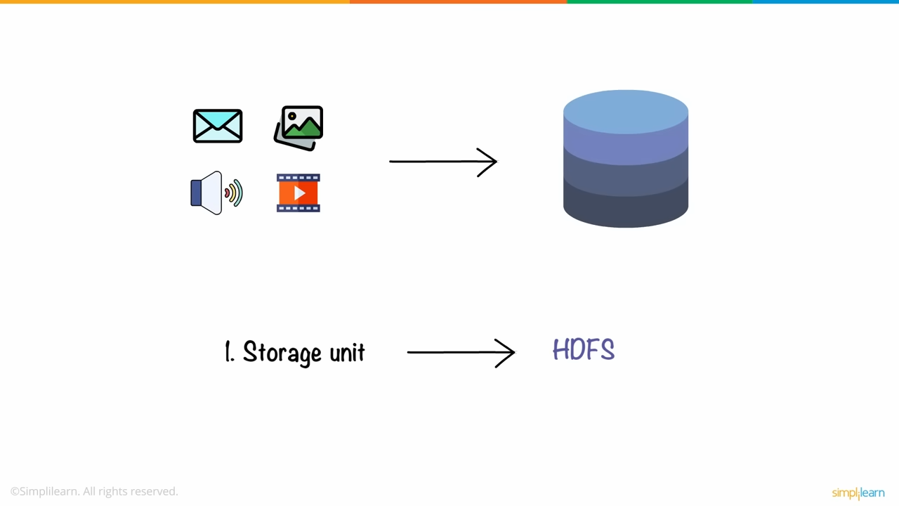
Storage unit -> the hadoop distributed file system or hdfs

Slide 9
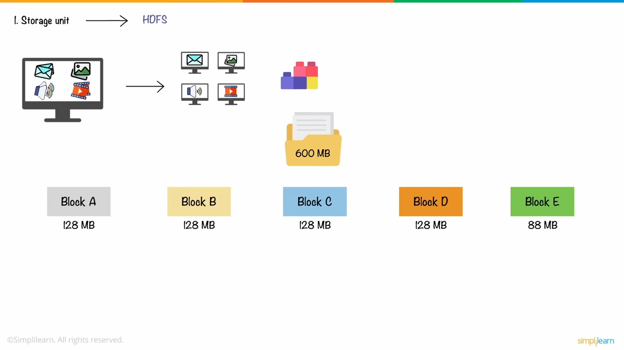
Storing data in one computer unfeasible hence data is distributed
amongst many computers and stored in blocks

Slide 10
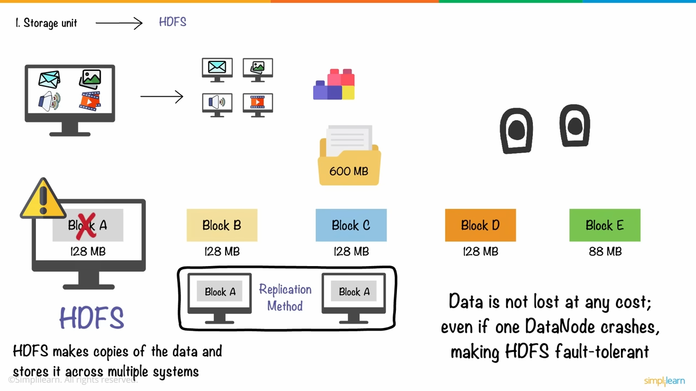

Slide 11
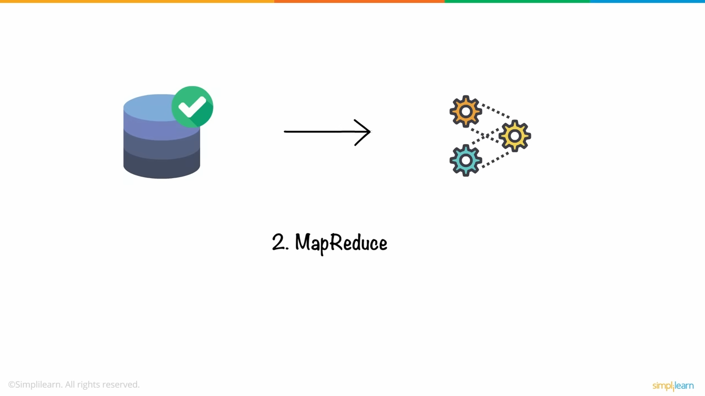

Slide 12
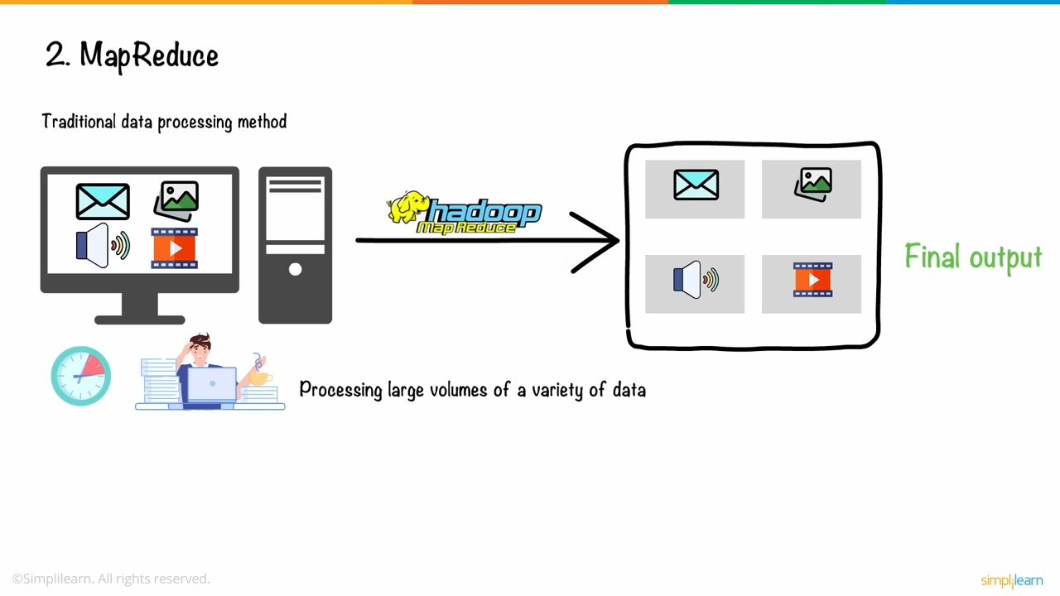

Slide 13
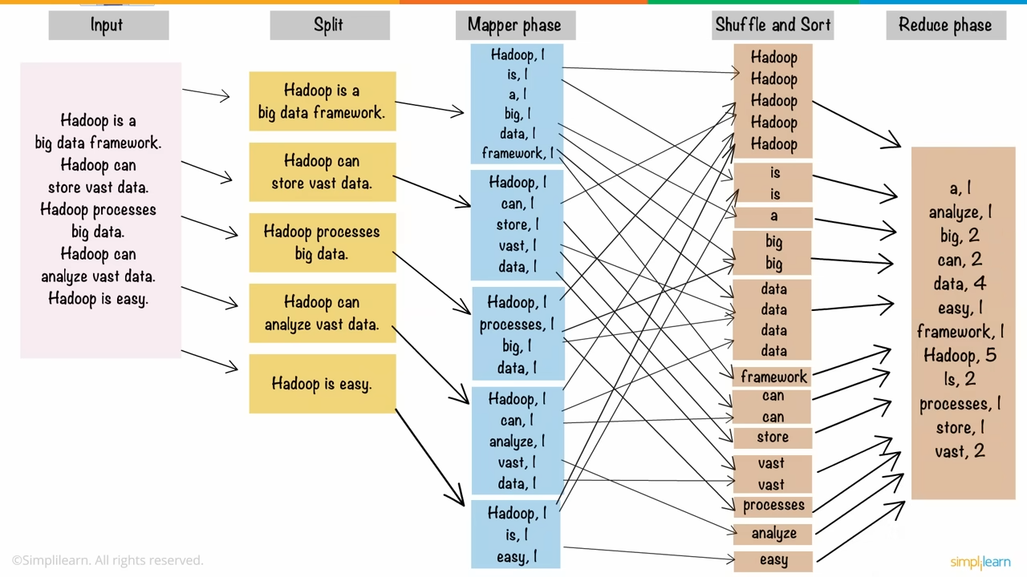

Slide 14
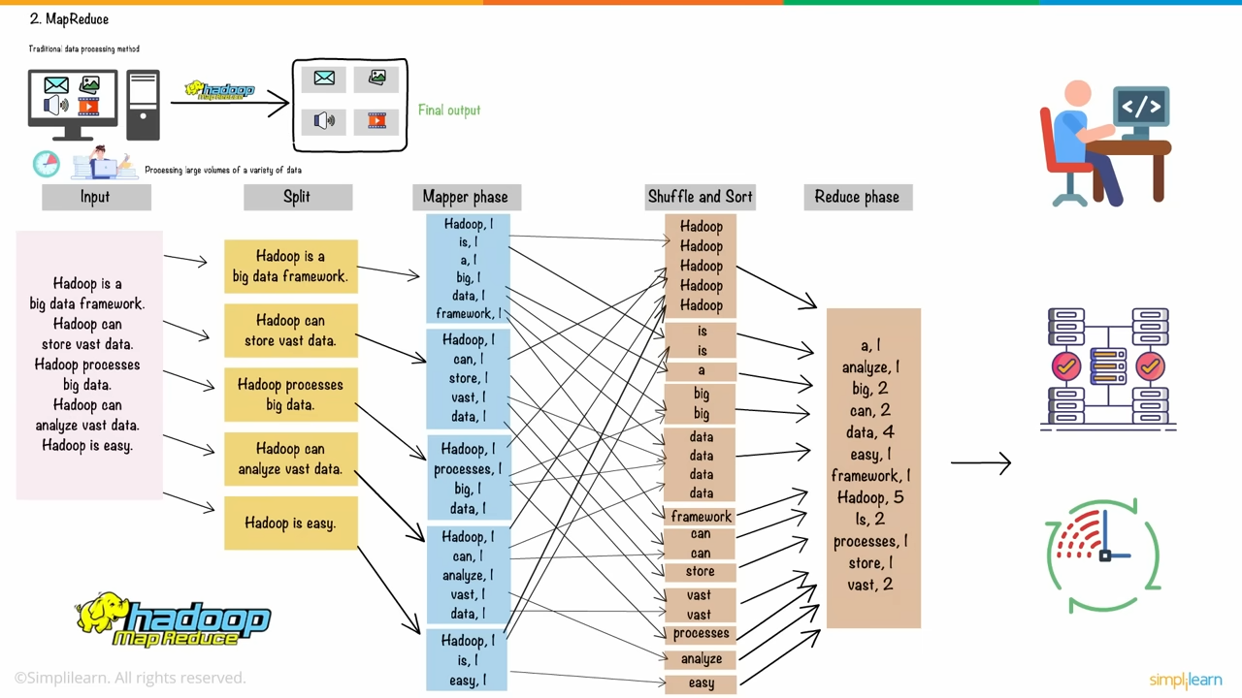
Improve load
balanacing and saves
time

Slide 15
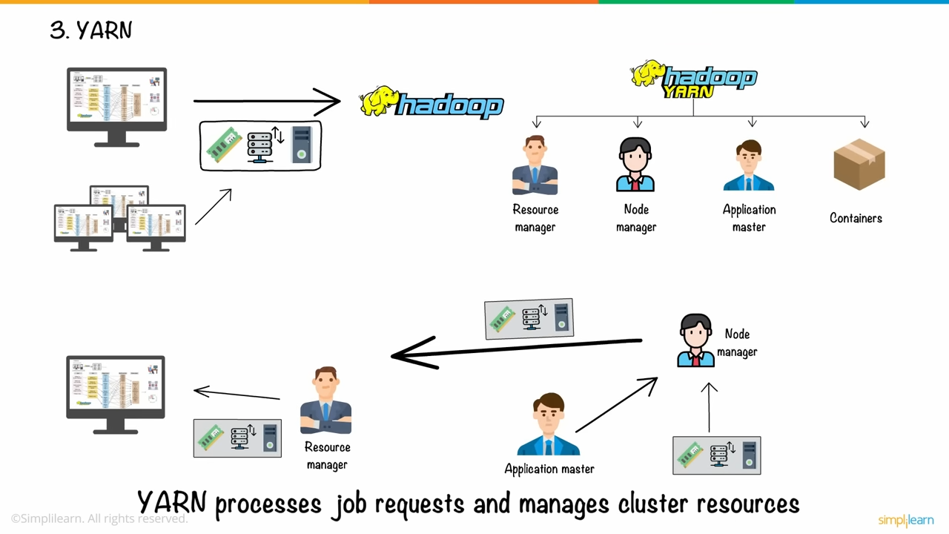

Slide 16
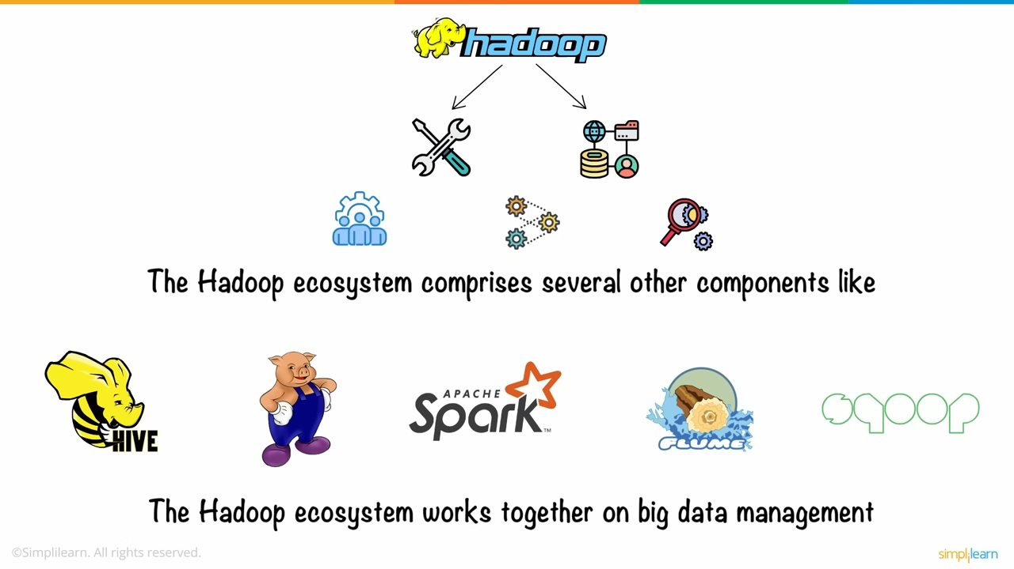

Slide 17
